Slide 1

Inferring Assembly Objects and Sequences from Demonstrations
Learning Algorithms and Systems Laboratory
Final Presentation - 17 June 2019
Student: Mahdi Nobar
Supervisor: Dr Aude Billard
Assistant: Dr Athanasios Polydoros
Master Semester Project 10 Credits

Slide 2
Outline
Project Definition
Requirements and Options
Workflow
Demonstration
Conclusion
Notes:
Project Definition
Motivatio
State Of The Art
Requirements
Simulation Options
Project Progress
Next Steps
Gantt Chart

Slide 3
Project
Definition
Unsupervised Learning
Inferring Assembly
Data Processing
Computer Vision
Notes:
The ultimate goal of this project is to analyze Inferring Assembly process by data pr-processing, unsupervised learning and computer vision techniques.
In fact, the proposed intelligent system gathers machine learning, vision and data pre processing methods and can be used for a vision guided assembly robots.

Slide 4
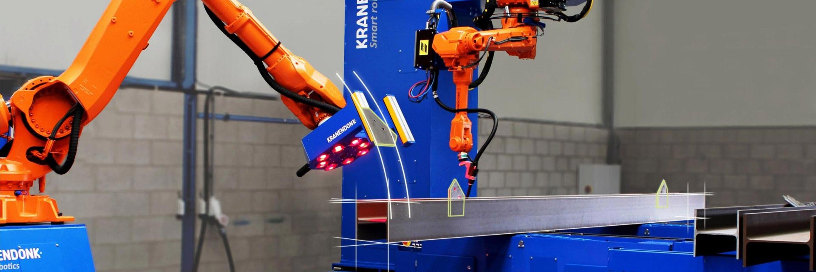
Motivation
Vision Guided Assembly Robots
Non-repetitive production
Less mechanical set up
Arbitrary initial position and orientation
Robotic assembly automation; KRANENDONK; https://www.kranendonk.com/sites/default/files/styles/full_width_images/public/robotic_beam_assembly-kranendonk.jpg?itok=8q_ujAxn
Notes:
Automate non-repetitive production
Less mechanical set up (storage, fixture, changeover time)
Arbitrary initial orientation
Integration with secondary operations such as deburring, washing, measuring

Slide 5
Requirements
Data Acquisition
Image
Analysis Tool
Machine Learning Tool

Slide 6
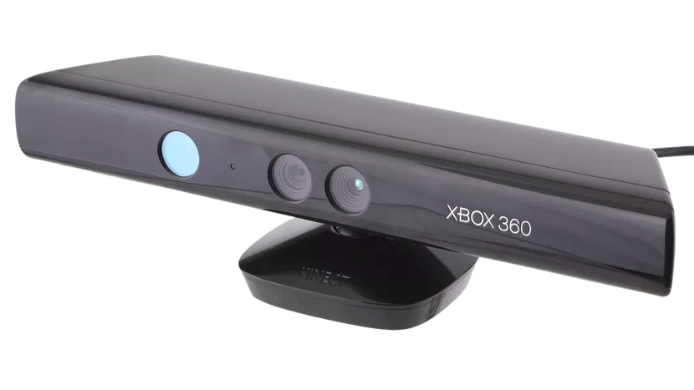



Available Options
Kinect Xbox 360 V1
OpenCV
Open3D
Scikit-learn
Notes:
What is available for simulation?

Slide 7
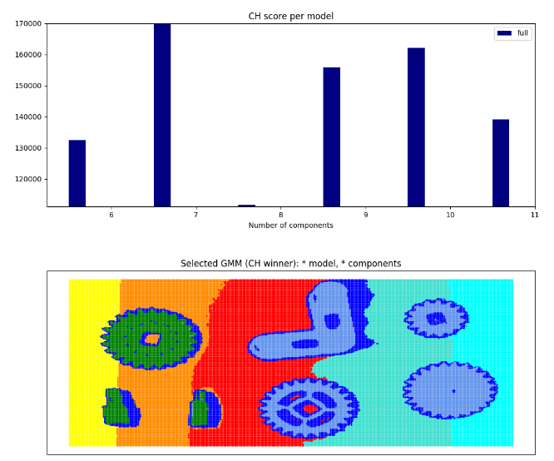
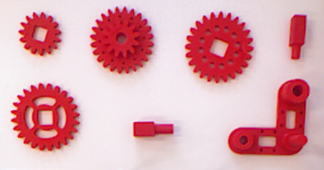
Clustering
Calinski-Harabasz score permodel
Background Effect
GMM
Calinski-Harabasz Index
number of components
GMM (model with minimum CH)
Notes:
Calinski-Harabasz Index Advantages:
The score is higher when clusters are dense and well separated, which relates to a standard concept of a cluster.
The score is fast to compute

Slide 8
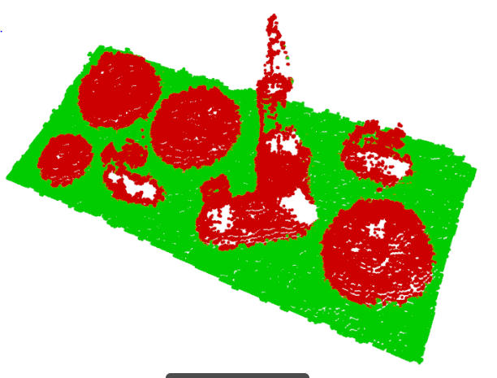
Background Removal
GMM with 2 clusters
Notes:
Why GMM initially could not detect the components?

Slide 9
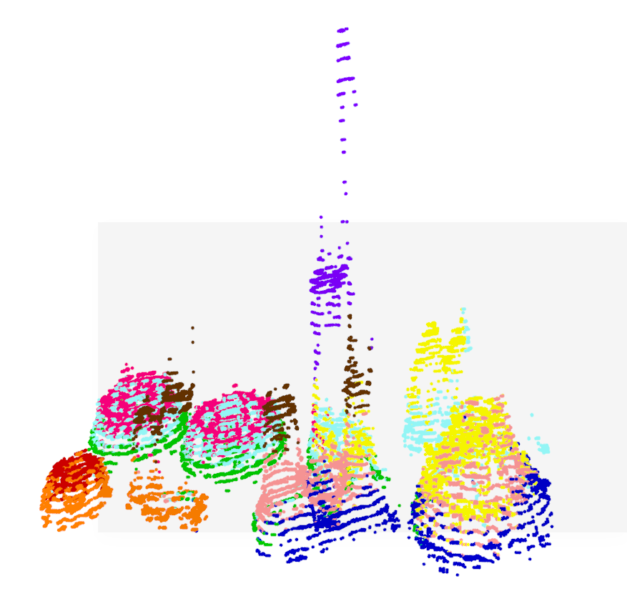
Gaussian Mixture Model
Data Noise
Object Shade Effect
Small Objects
Different Shapes
Short Distance between Objects
6 features
Removed background
K=7
PCA with 4 components 99 percent of variance
Notes:
Why GMM initially could not detect the components?

Slide 10
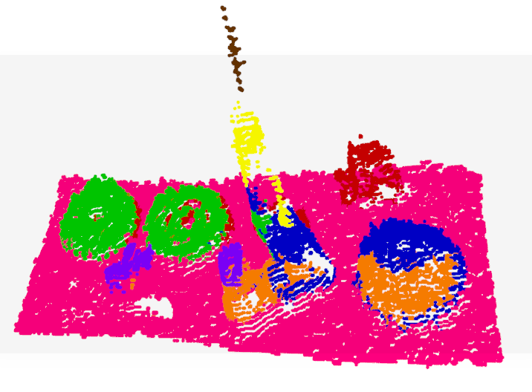
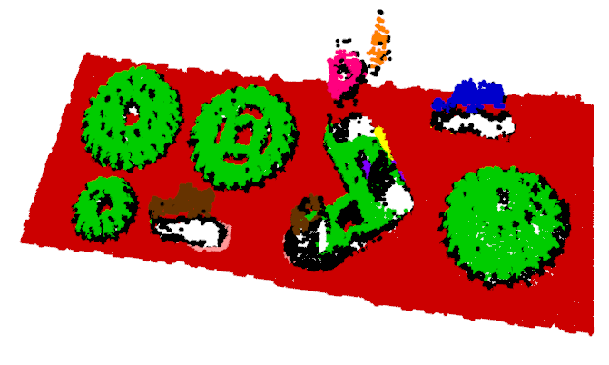
DBSCAN model
Birch model
Workflow
Notes:
The Birch builds a tree called the Characteristic Feature Tree (CFT) for the given data. The data is essentially lossy compressed to a set of Characteristic Feature nodes (CF Nodes). The CF Nodes have a number of subclusters called Characteristic Feature subclusters (CF Subclusters).
The Birch algorithm has two parameters, the threshold and the branching factor. The branching factor limits the number of subclusters in a node and the threshold limits the distance between the entering sample and the existing subclusters.
This algorithm can be viewed as an instance or data reduction method, since it reduces the input data to a set of subclusters which are obtained directly from the leaves of the CFT.

Slide 11
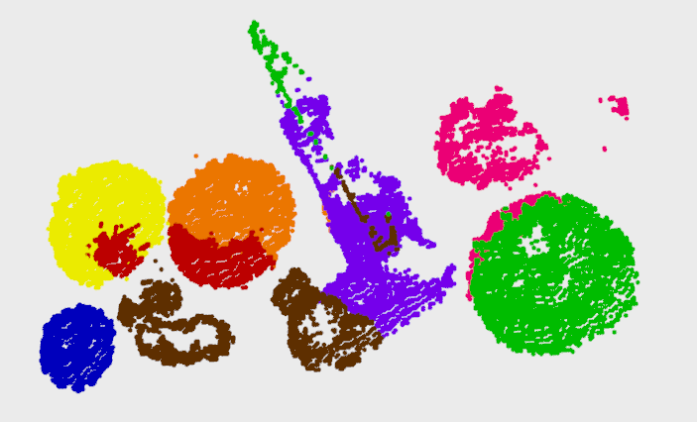
Gaussian Mixture Model
Workflow
6 features
K=8 with based on Calinski-Harabaz Index
No PCA
Removed background
Point Cloud for intrinsic camera calibration
Data Normalization
Notes:
For clusters, the Calinski-Harabaz score is given as the ratio of the between-clusters distribution mean and the within-cluster distribution:
2.3.9.6.1. Advantages
The score is higher when clusters are dense and well separated, which relates to a standard concept of a cluster.
The score is fast to compute
2.3.9.6.2. Drawbacks
The Calinski-Harabaz index is generally higher for convex clusters than other concepts of clusters, such as density based clusters like those obtained through DBSCAN.

Slide 12
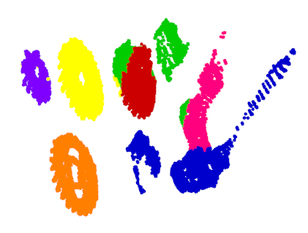
Gaussian Mixture Model
Workflow
2 features (x,y)
K=7 without Index
No PCA
Removed background
Point Cloud for intrinsic camera calibration
Data Normalization
Notes:
For clusters, the Calinski-Harabaz score is given as the ratio of the between-clusters distribution mean and the within-cluster distribution:
2.3.9.6.1. Advantages
The score is higher when clusters are dense and well separated, which relates to a standard concept of a cluster.
The score is fast to compute
2.3.9.6.2. Drawbacks
The Calinski-Harabaz index is generally higher for convex clusters than other concepts of clusters, such as density based clusters like those obtained through DBSCAN.

Slide 13
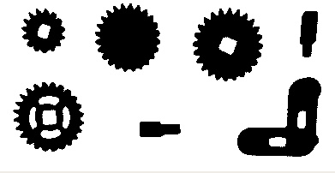
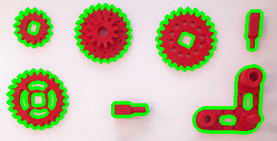
Contour Detection

Slide 14
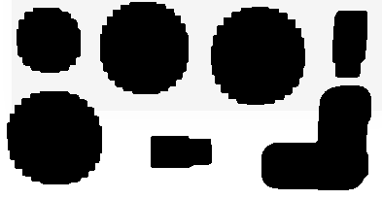
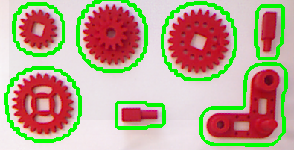
Contour Detection
Remove Unwanted Contours
Dilation
Notes:
Satoshi Suzuki and others. Topological structural analysis of digitized binary images by border following. Computer Vision, Graphics, and Image Processing, 30(1):32–46, 1985.

Slide 15


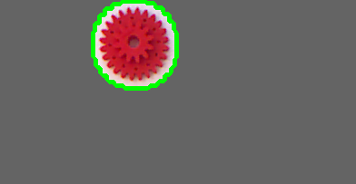


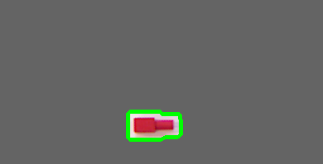
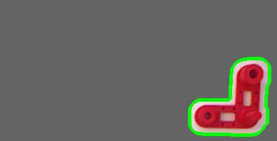
Contour Detection and Normal Distribution
3 features (x,y,z)
Initial Conditions
Notes:
Standardization influences at each loop===> we needed to have the index of the center of contours at point cloud===> we need each frame size after point cloud to remain the same and not to remove out some pixels (not remove out zero depth pixels after standardization)

Slide 16
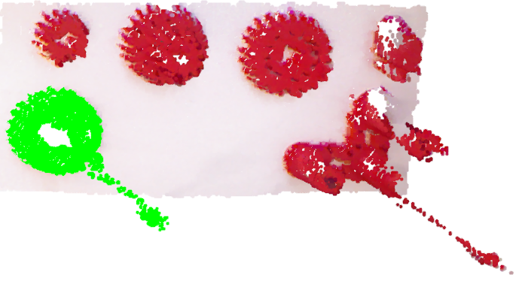
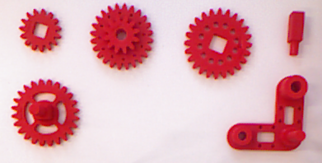
Assembled Objects Detection
Kullback–Leibler divergence
Sort
Detect Missing Object
Max
Detect Assembled Objects
Notes:
In mathematical statistics, the Kullback–Leibler divergence (also called relative entropy) is a measure of how one probability distribution is different from a second, reference probability distribution.
In probability and statistics, the Hellinger distance (closely related to, although different from, the Bhattacharyya distance) is used to quantify the similarity between two probability distributions.

Slide 17
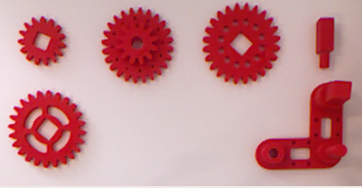
Assembly of L-shaped with Small Bar
Data Noise Effect
Notes:
In mathematical statistics, the Kullback–Leibler divergence (also called relative entropy) is a measure of how one probability distribution is different from a second, reference probability distribution.
In probability and statistics, the Hellinger distance (closely related to, although different from, the Bhattacharyya distance) is used to quantify the similarity between two probability distributions.

Slide 18
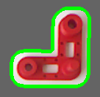
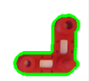
Tight Contours
Remove Unwanted Contours
No Dilation
Threshold Contour Number of Points
Notes:
In mathematical statistics, the Kullback–Leibler divergence (also called relative entropy) is a measure of how one probability distribution is different from a second, reference probability distribution.
In probability and statistics, the Hellinger distance (closely related to, although different from, the Bhattacharyya distance) is used to quantify the similarity between two probability distributions.

Slide 19
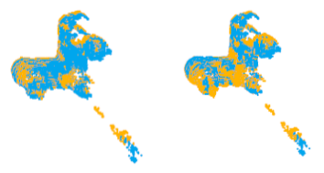
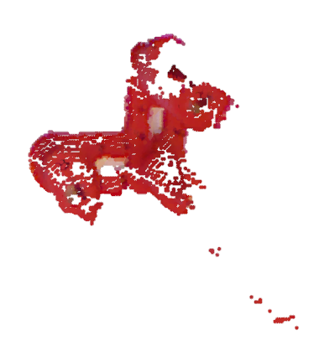
Noise Reduction
Point-to-Point ICP Registration
Before Registration
After Registration
After
Removal of 15% mismatched points
Point Cloud 1
Scene
Remove Ratio of Points with Large Distance
Final
Point Cloud
ICP Registration
Point Cloud 2

Slide 20
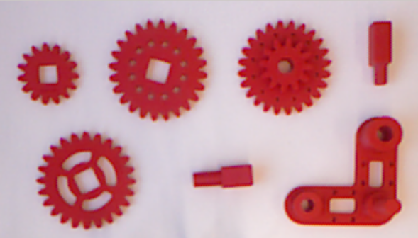
Noise Reduction
Input frame: Same scene taken separately
On average 70% Reduction of Kullback Divergence
 | Bar | Hollow Gear | L-Shape | Small Gear | Small Bar | Double-Row Gear | Large Gear
 | Kullback Divergence
Without Noise Reduction | 0.007 | 0.044 | 0.006 | 0.072 | 0.034 | 0.011 | 0.017
With Noise Reduction | 0.004 | 0.03 | 0.003 | 0.002 | 0.11 | 0.006 | 0.002
Notes:
In mathematical statistics, the Kullback–Leibler divergence (also called relative entropy) is a measure of how one probability distribution is different from a second, reference probability distribution.
In probability and statistics, the Hellinger distance (closely related to, although different from, the Bhattacharyya distance) is used to quantify the similarity between two probability distributions.

Slide 21
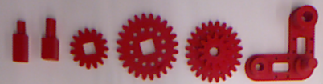
Test Results
Pre-assumption:
The missing object is merged with another object at the same frame
Total Number of Assembly Tests | Number of Correct Missing Object Inference | Number of Correct Merged Pair Inference
15 | 15 | 12
 | 100 % correct | 80 % correct
Notes:
In mathematical statistics, the Kullback–Leibler divergence (also called relative entropy) is a measure of how one probability distribution is different from a second, reference probability distribution.
In probability and statistics, the Hellinger distance (closely related to, although different from, the Bhattacharyya distance) is used to quantify the similarity between two probability distributions.

Slide 22
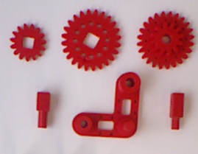
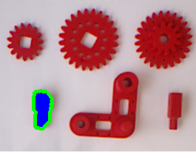
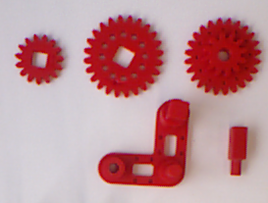
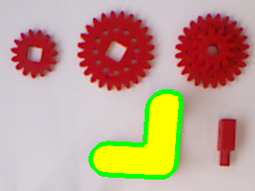
Demonstration: Assembly Sequence (1)
Source 1
Missing Object
Source 2
Merged Pair

Slide 23
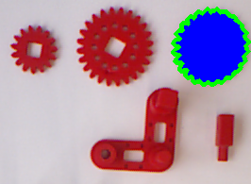
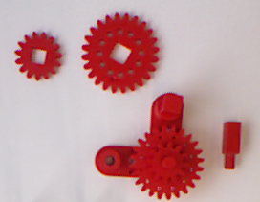
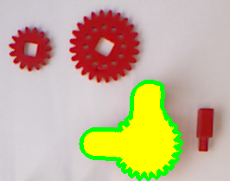
Demonstration: Assembly Sequence (2)
Source 1
Missing Object
Source 2
Merged Pair

Slide 24
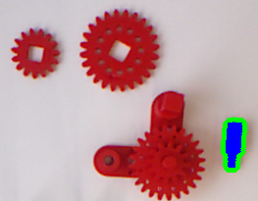
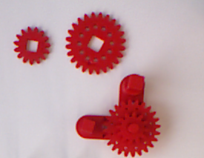
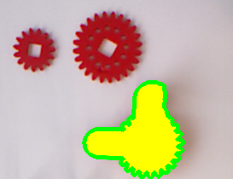
Demonstration: Assembly Sequence (3)
Source 1
Missing Object
Source 2
Merged Pair

Slide 25
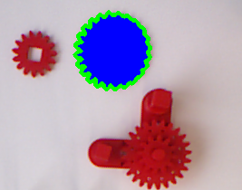
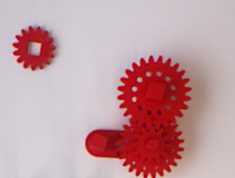
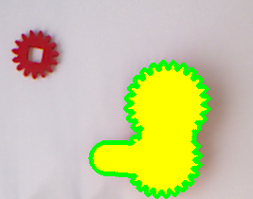
Demonstration: Assembly Sequence (4)
Source 1
Missing Object
Source 2
Merged Pair

Slide 26
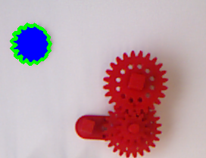
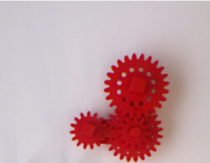
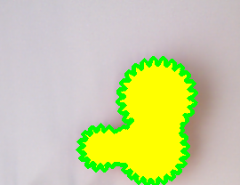
Demonstration: Assembly Sequence (5)
Source 1
Missing Object
Source 2
Merged Pair

Slide 27
Conclusion
Detection of number of objects
Detection of missing object
Inference of sequence of merged pair of objects

Slide 28
Future Improvements
Inference of the position of the merged object
Increase the speed of inference
Make system more robust to the input
Notes:
Now elapsed time is about 40 seconds for each inference

Slide 29
Thank You For Your Attention.
Questions?

Slide 30
References
[1] Oleksandr Semeniuta, Sebastian Dransfeld, Petter Falkman; Vision-based robotic system for picking and inspection of small automotive components; IEEE International Conference on Automation Science and Engineering, 2016
[2] David A. Duque, Flavio A. Prieto, Jose G. Hoyos; Trajectory generation for robotic assembly operations using learning by demonstration; Robotics and Computer Integrated Manufacturing; 2018
[3] Oleksandr Semeniuta, Sebastian Dransfeld, Kristian Martinsen, Petter Falkman; Towards increased intelligence and automatic improvement in industrial vision systems; 11th CIRP Conference on Intelligent Computation in Manufacturing Engineering; 2017
[4] Sergey Levine, Chelsea Finn, Trevor Darrell, Pieter Abbeel; End-to-End Training of Deep Visuomotor Policies; Journal of Machine Learning Research; 2016

Slide 31
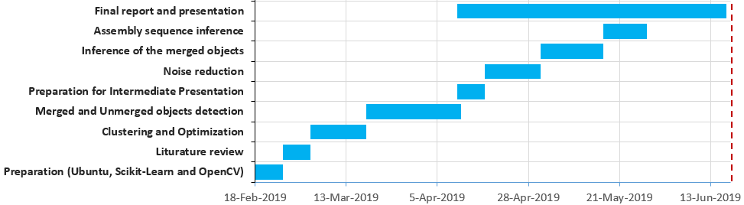
Gantt Chart

Slide 32
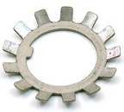
State of Art
Goal: star-washer pose estimation
Workflow:
Identify Star-washer
Cartesian-to-polar transformation
Segmentation
Supervised machine learning
Semeniuta et al.; Vision-based robotic system for picking and inspection of small automotive components
Vision-based robotic system for picking and inspection of small automotive components by Semeniuta et al. [1]
Notes:
Semeniuta et al.; Vision-based robotic system for picking and inspection of small
automotive components [1]
Small manufacturing components
Proposes: multi-camera,multi-pose inspection solution
Goal (challenge): inspection of star-washer orientation on the feeder to guide the robot to pick only those starwashers in the correct orientation
Workflow:
Identify Starwasher
Classification of Their Orientation
Segmentation of Starwashers teeth using Cartesian-to-polar transformation, analysis
of polar images of various resolutions, and classification using supervised machine learning.

Slide 33
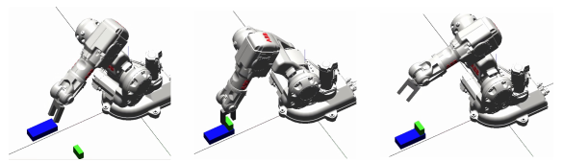
State of Art cont.
Duque et al.; Trajectory generation for robotic assembly operations using learning by demonstration
Kinect sensor
Training TP-GMM model
Object Detection
Trajectory generation for robotic assembly operations using learning by demonstration by Duque et al. [2]
Notes:
Data Acquisition using kinect sensor and Learn by Demonstration
Training TP-GMM model:Task Parametrized GMM model (TP-
GMM) is to generate trajectories based on a set of parameters that
characterize the task (e.g origin of the observer and the transformation
matrix)
Generation of new trajectories by having trained model from TP-GMM and detected object on the scene by Kinect sensor

Slide 34
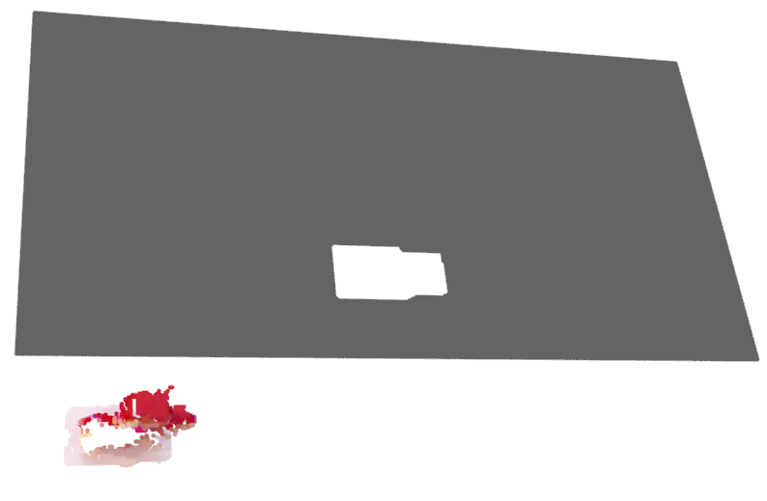
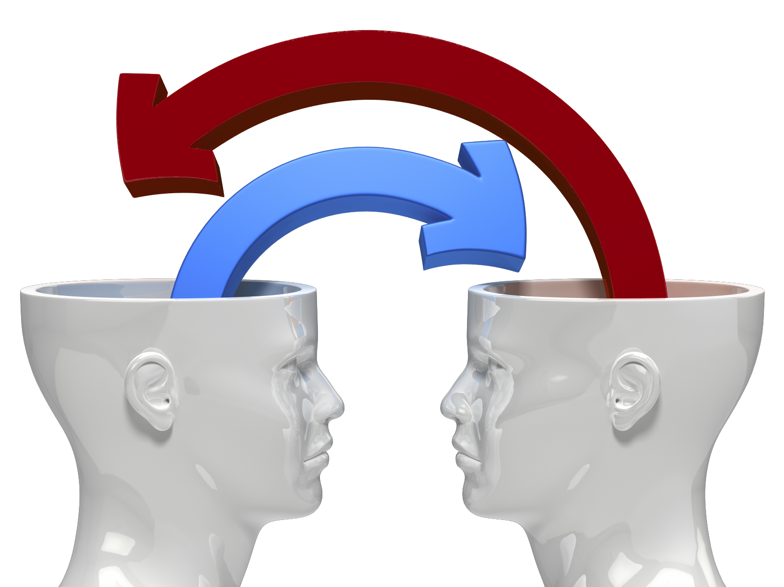
Finding Initial Conditions
Workflow cont.

Slide 35
Inferring Assembled Objects
Initial scenario

Slide 36
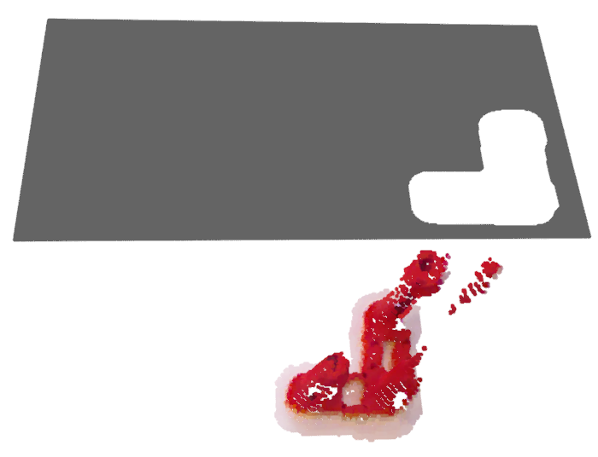
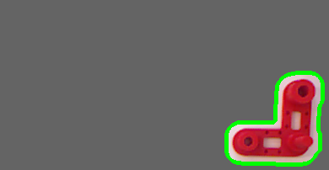
Inferring Assembled Objects cont.
Workflow cont.
Notes:
Standardization influences at each loop===> we needed to have the index of the center of contours at point cloud===> we need each frame size after point cloud to remain the same and not to remove out some pixels (not remove out zero depth pixels after standardization)

Slide 37
Point-to-Point Registration
Input frame
 | Small Bar | Hollow Gear | L-Shape | Small Gear | Bar | Double-Row Gear | Large Gear
Without Noise Reduction | 0.007 | 0.044 | 0.006 | 0.072 | 0.034 | 0.011 | 0.017
With Noise Reduction | 0.004 | 0.03 | 0.003 | 0.002 | 0.11 | 0.006 | 0.002
Notes:
In mathematical statistics, the Kullback–Leibler divergence (also called relative entropy) is a measure of how one probability distribution is different from a second, reference probability distribution.
In probability and statistics, the Hellinger distance (closely related to, although different from, the Bhattacharyya distance) is used to quantify the similarity between two probability distributions.

